Slide 1

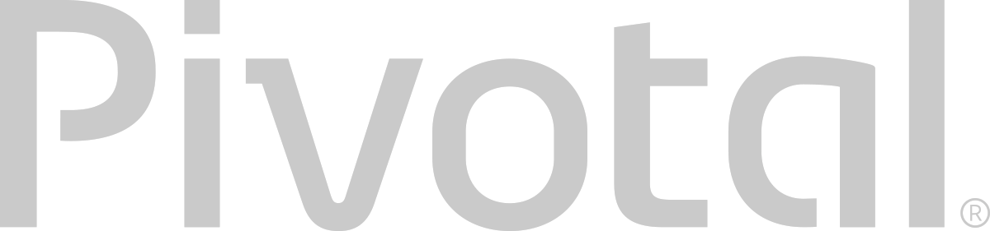
Introduction to
Pivotal Cloud Foundry
Ben Bertka / Platform Architect
bbertka@pivotal.io
@P3Geek
Notes:
Why we are here and what we are doing

Slide 2
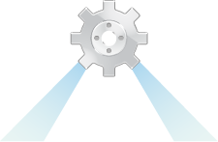
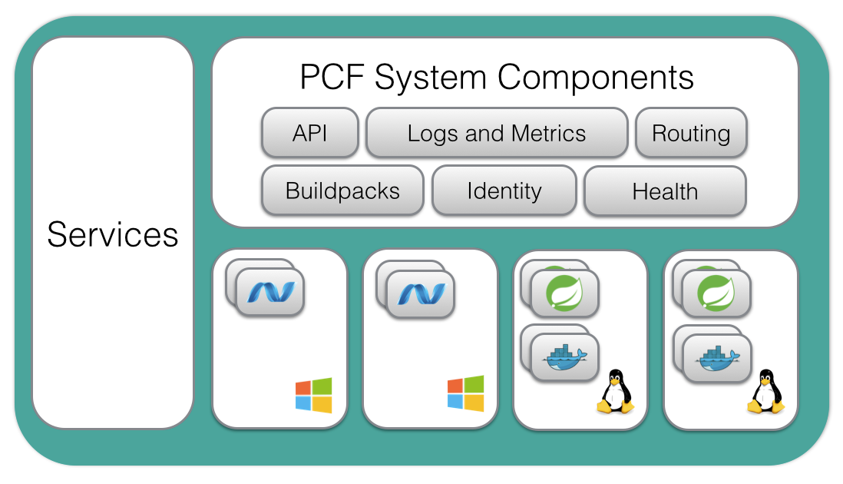
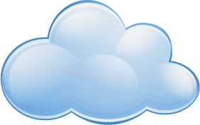


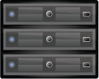
Fox Cloud Foundry
Location
Accessible
Data Center
(Corp Network)
Mongo
vCenter
Network
Runs all your APIs and apps/services:
Ruby
NodeJS
Java
Python
PHP
Docker
.NET
…
Legacy
Corporate Network
Others (MSSQL?)
BOSH
Others (ORACLE?)

Slide 3
Agenda
Changing Development Models
Cloud Native Ecosystem & Platforms
Pivotal Cloud Foundry
‹#›
Notes:
I wanted to go over some of these emerging development models and
how tech companies have been successful in moving to these highly composable, resilient application architectures that we’re referring to as cloud native applications.
I want to show you what kind of platform tools the leading tech companies had to build.
And how these new designs are really hitting a lot of enterprises, companies that don’t depend on software directly.
We also want to showcase how these projects work together with a demo of a microservice-based Java app, built with Spring Boot and Netflix OSS projects
Before we turn it over to discussion

Slide 4
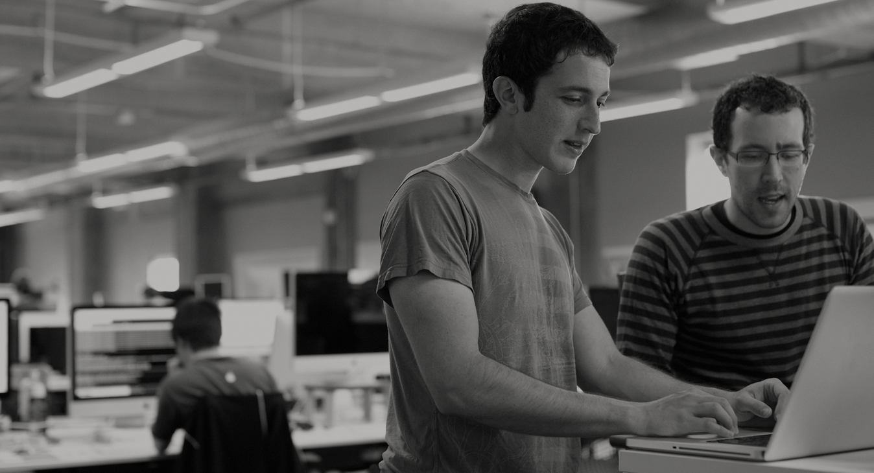

WE BELIEVE
Transforming how the world builds software will shape the future.
Notes:
At Pivotal, we believe Transforming how the world builds software will shape the future.
This is our core guiding principle that shapes our product and corporate strategy. Our success today is your success five years from now. With the ever expanding innovation gap between companies stuck with the status quo, and those companies pivoting with new practices and technology gaining the market, staying competitive means transforming at the core of the business, and in today’s world this core is not just the technology that runs the datacenter anymore, rather its the software development loop that cradles the market innovations, and the operations loop which enables innovation to flow freely. Achieving agility in dev and ops is the keystone to success in a rapidly growing technology space increasingly dominated by lean startups.

Slide 5
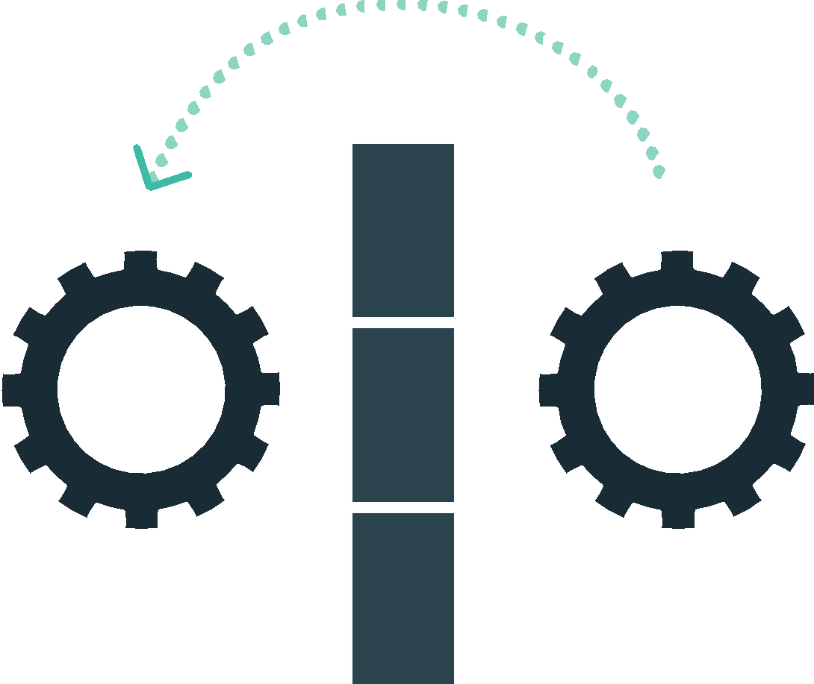
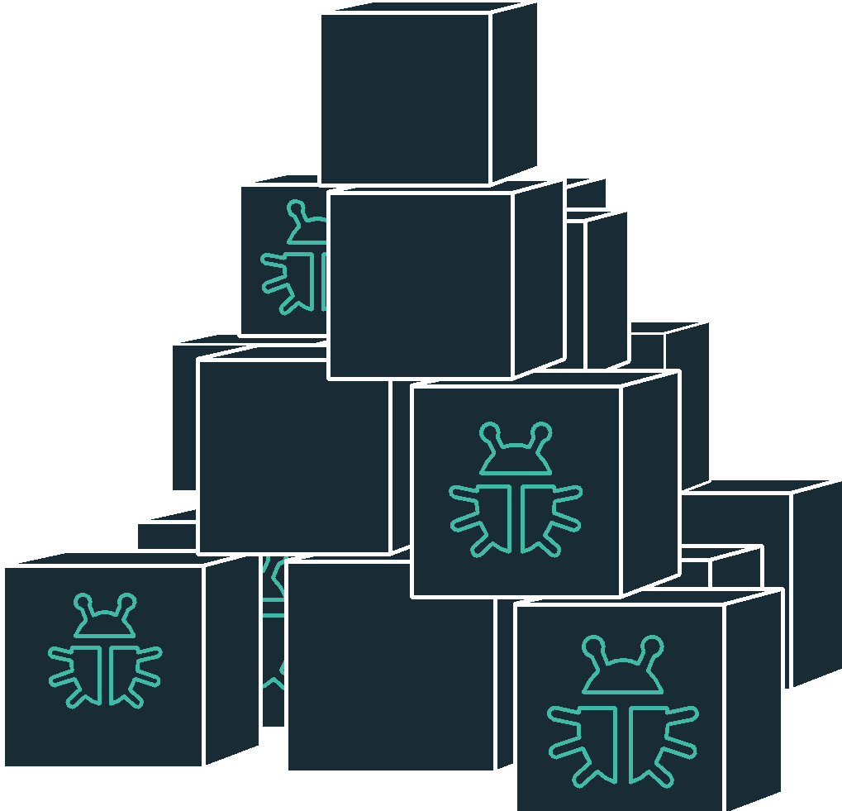
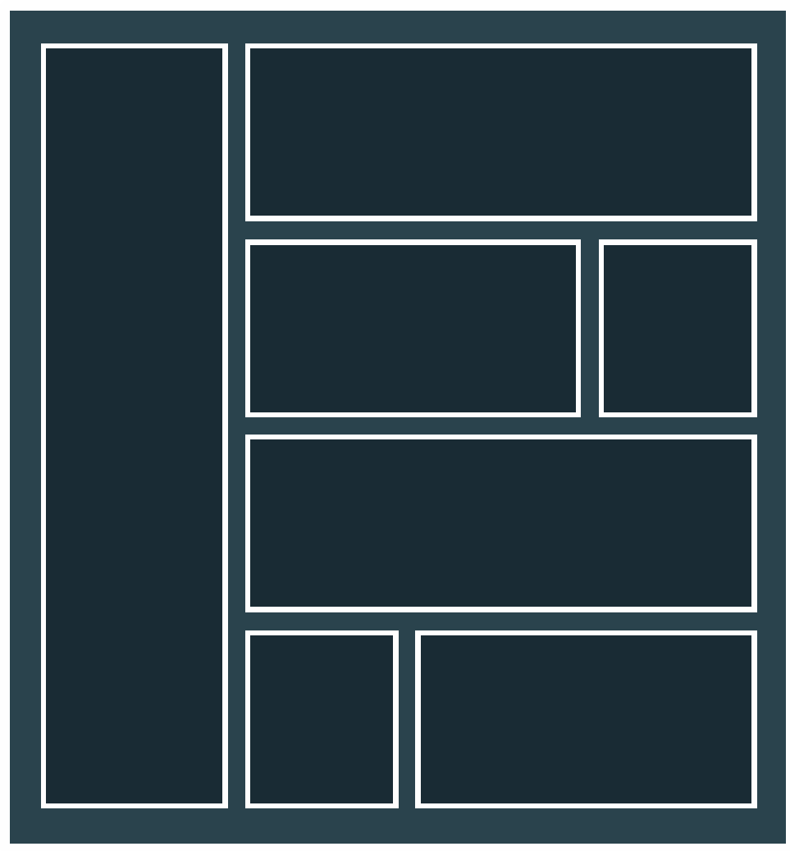
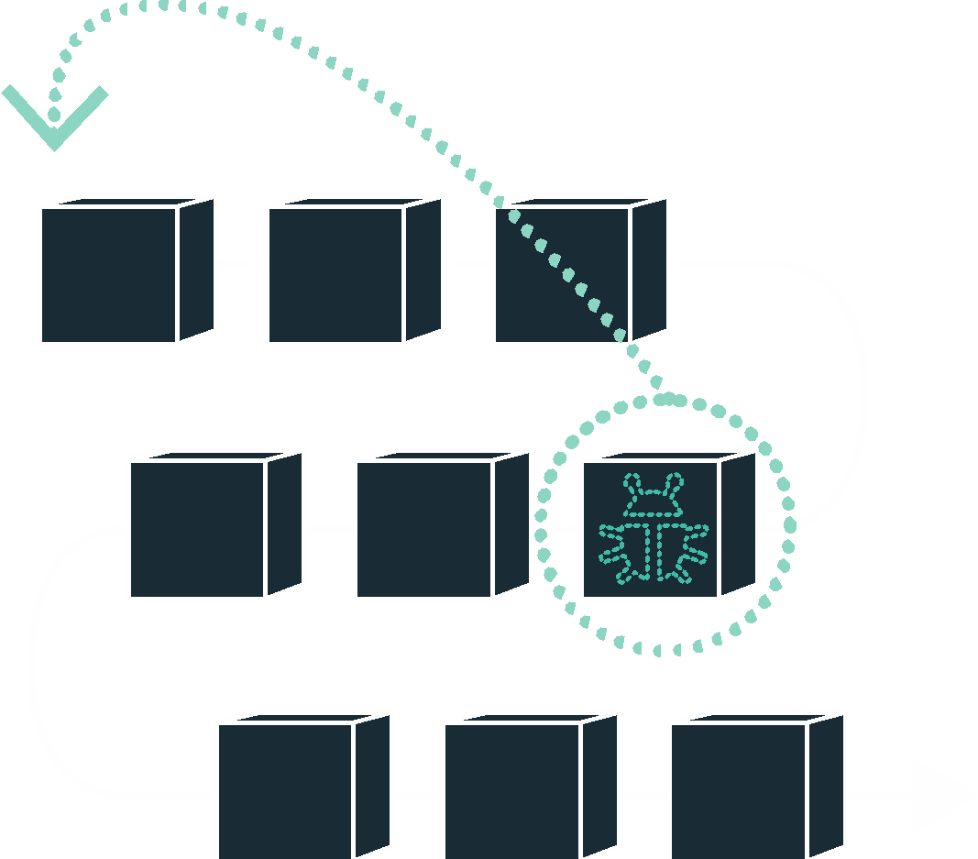
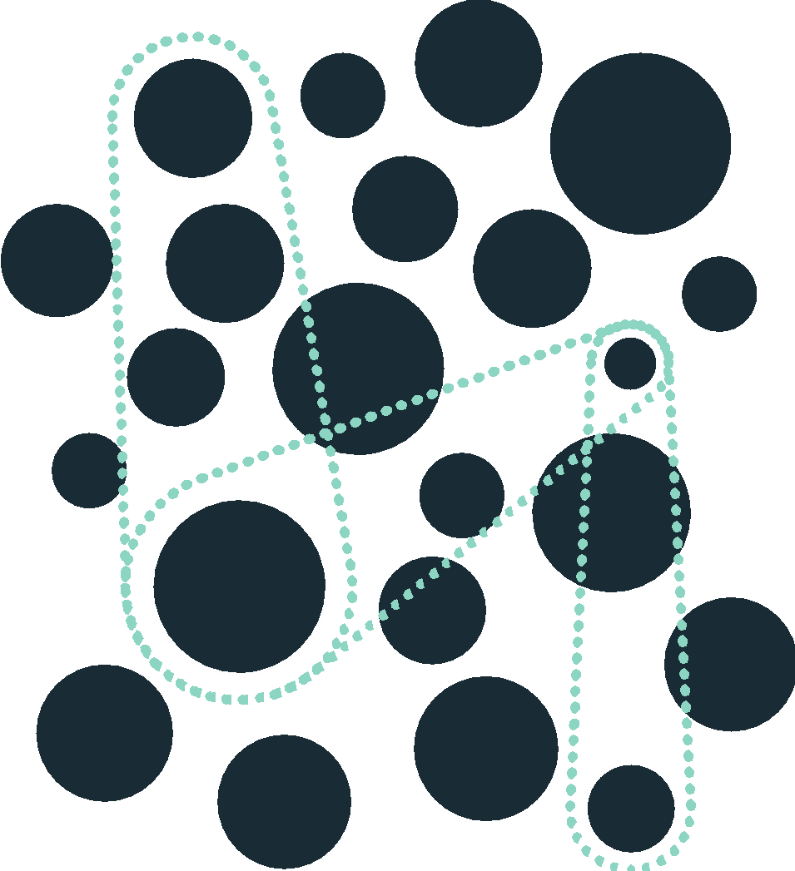
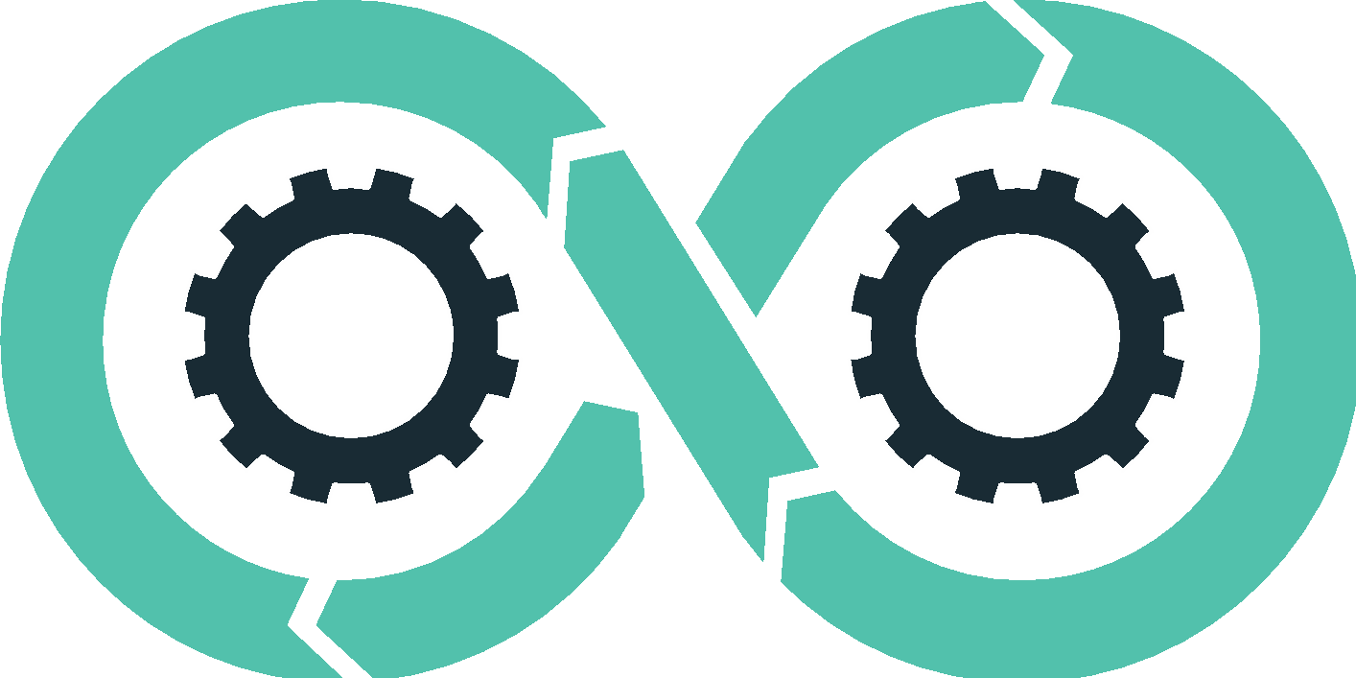
DevOps
Continuous Delivery
Microservices
Not my problem
Separate tools, varied incentives, opaque process
Release once every 6 months
More Bugs in production
Tightly coupled components
Slow deployment cycles
Shared responsibility
Common incentives, tools, process and culture
Release early and often
Higher Quality of Code
Loosely coupled components
Automated deployments
Notes:
Ensuring that you are set up to support new (changing) dev patterns with architectural and operations patterns that support "cloud native"; does your deploy velocity match your build velocity?

Slide 6
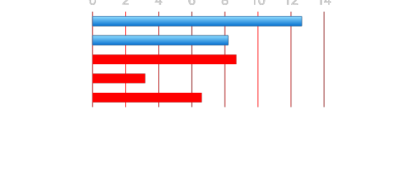
Software Developers Spend too Much Time NOT Writing Software
Design and Coding
Brainstorming
Administrative tasks
Managing Environments
Waiting for Test/Build
Average Hours/Week
17.5 hrs ~ 40% of full work week!
Sources: “Electric Cloud LinkedIn Survey to software developers”
Notes:
Companies cant be agile with all the process and overhead to get anything done.

Slide 7
IT Ops Spends Time Building Snowflakes
IT Operations on a Cloud Native Platform
Request VMs
Request Network
Request Software Install
Request Database
Random Network Troubleshooting
14
0
0
0
14
0
4
7
6
DAYS
0
Nearly 3 months later
0
21
15
0
MVP in
about a
month
5
21
15
10
3
0.25
0.02
Random Middleware/OS Troubleshooting
Develop App
User Acceptance Testing
QA/Production Deploy Pipeline
Scale Up/Down
Need to Innovate Here
Notes:
What is your process for standing up dev, test, and prod environments?
Is this relevant for their Market?

Slide 8
Cloud Foundry Helps Close the Innovation Gap
Key Performance Indicators for Market Leadership
Agile/Developer Productivity/TDD
Continuous Delivery
DevOps
Cloud-native App Design
Culture/Talent
Startups
DevOps, CD, Agile
Enterprise PaaS
Expectations
&
Efficiency
Innovation Gap
DIY Automation
IaaS
Traditional IT
Time

Slide 9
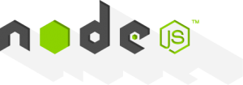
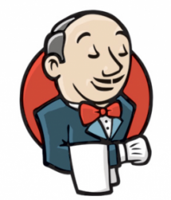
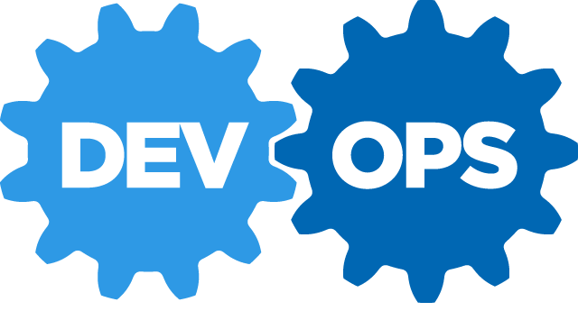

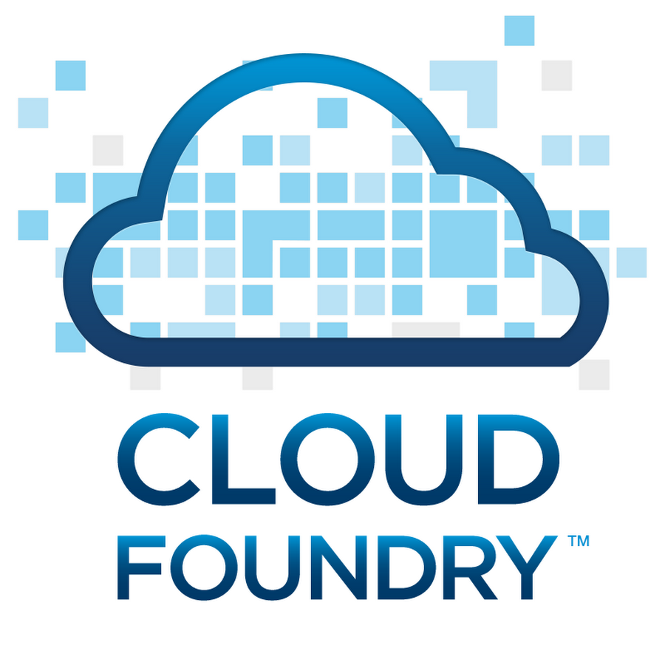
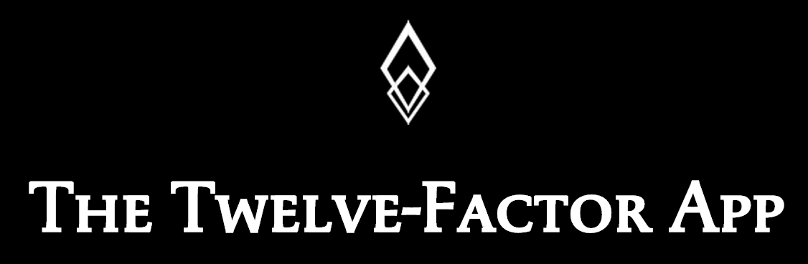


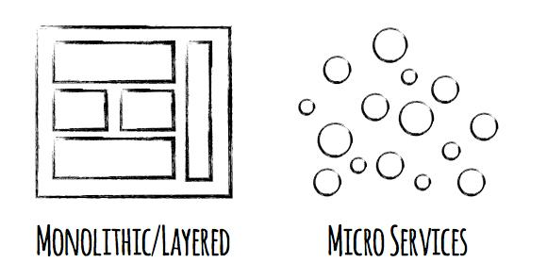
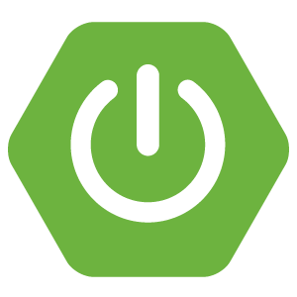

Software is EVOLVING
Continuous Delivery
Spring Boot
Notes:
Software is changing industries but software itself is changing. You hear a lot about buzz-words and new technologies coming to play with ideas such as Microservices, DevOps, Continuous Delivery and of Containerization of workloads made popular by Docker.
Being a modern developer is challenging because it requires constantly updating ones knowledge and skills, but its also so exciting, because never before have we been able to get into the flow with less technical roadblocks.
By the end of today, youll be fluent in all these technologies.

Slide 10
What are Microservices?
If every service has to be updated in concert, it’s not loosely coupled!
Loosely coupled service oriented architecture with bounded contexts
If you have to know about surrounding services you don’t have a bounded context.
Notes:
I presume you’re all familiar with microservices and cloud-native, but quickly, here’s an introduction. They’re loosely coupled, service oriented architecture with bounded contexts.
Because each service can be updated independently, your teams can work in parallel. Because each service is isolated, it’s much easier to automate your testing.

Slide 11
Trend towards new Lightweight Architectures
X
X
MONOLITHIC/LAYERED
MICROSERVICES
Notes:
Companies want to achieve this

Slide 12
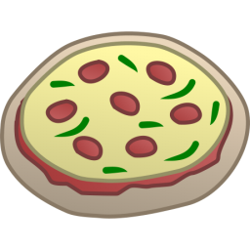



Agile Companies use Non-traditional, Modular Approaches to Software Systems
Relational
DB
Key/Value
Store
AQMP
…..........
Shared
DB
DB Service
Caching Service
Messaging Service
Two Pizzas Per Microservice = Manageable!
Notes:
Agile, Disruptive Companies Use Non-traditional, Modular Approaches to Software Systems

Slide 13
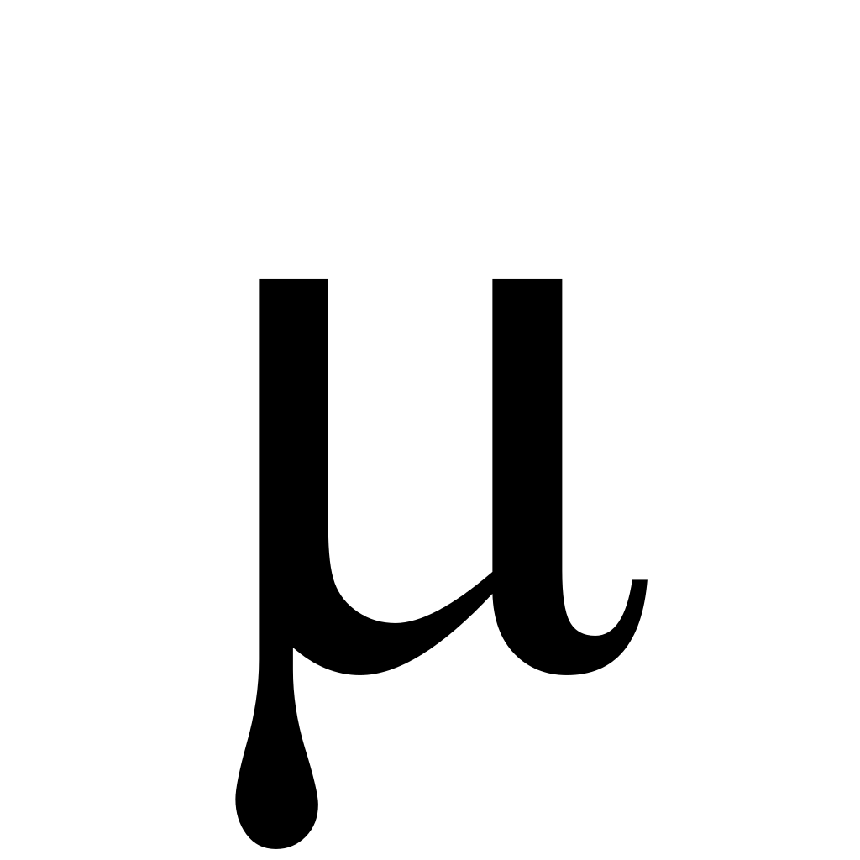
Evolving to a Microservice Strategy with Cloud Native Architecture (Ecosystem)
DATABASES AND DATA MANAGEMENT
Traditional RDBMS
Oracle MySQL
SQL Server
NoSQL datastores
MongoDB Cassandra
Couchbase
Cache and IMDG
Gemfire Coherence
VERSION CONTROL
Github
Gitlab
SVN
CI / CD
Jenkins
Concourse
Artifactory
SECURITY & COMPLIANCE
OAuth
UAA
LDAP
Kerberos
SSL/TLS
PCI
HIPAA/HL7
METRICS & DASHBOARDS
Collection
Storage
Dashboards
Alerts
Spinaker
DEVELOPMENT FRAMEWORKS
Spring / SCS
Entity Framework
Micro
API MANAGEMENT
APIGee
Mashery
DIY
What does it take to deploy and operate ALL this at SCALE
DATA MICROSERVICES
Spring Cloud DataFlow
Storm
Fink/NiFi
LANGUAGES
Java
.NET
Python
DISCOVERY & REGISTRATION
Consul
Eureka
etcd
CIRCUIT BREAKERS
Hystrix
DIY
LOAD BALANCING
Ribbon
Zuul (client side)
Ruby
Go
*.JS
Zookeeper
Where should your best developers focus to maximise BUSINESS VALUE?
MONITORING & LOGGING
Log Aggregation
Storage
Thresholds
Metering
CONTAINERS
MESSAGING
Garden Docker runC
Kafka RabbitMQ
CONTAINER
ORCHESTRATION
Cloud Foundry Runtime Kubernetes Swarm Marathon ECS
NETWORKING
DNS
Load Balancing
Intelligent Routing
Network Segmentation
Firewalls
CLOUD ORCHESTRATION
& AUTOMATION
BOSH / Cloud Foundry Chef Puppet Ansible SaltStack Mesos
PRIVATE CLOUD
PUBLIC CLOUD
vSphere OpenStack
AWS Azure GCP

Slide 14
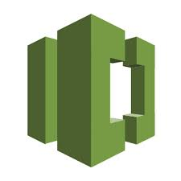
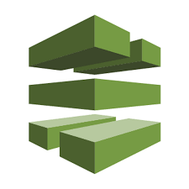
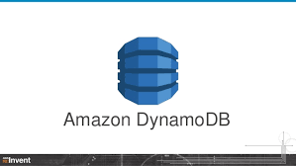
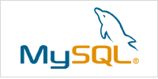
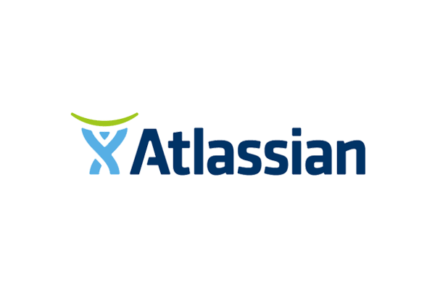

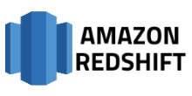
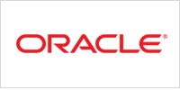
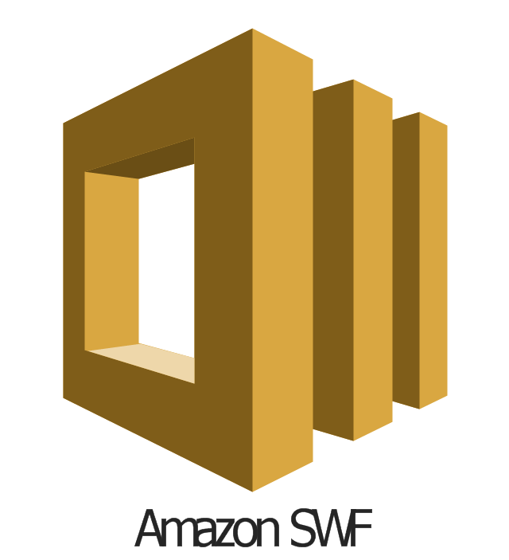
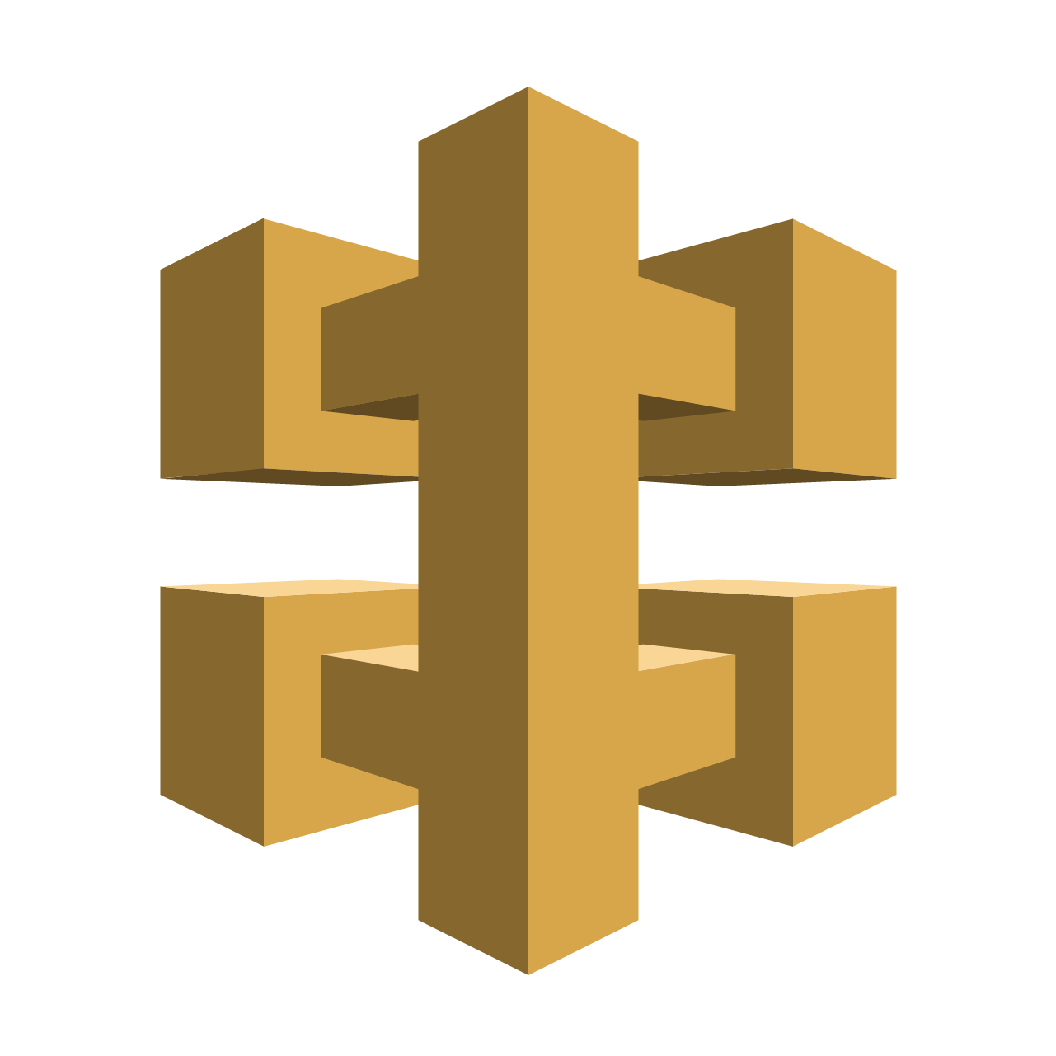
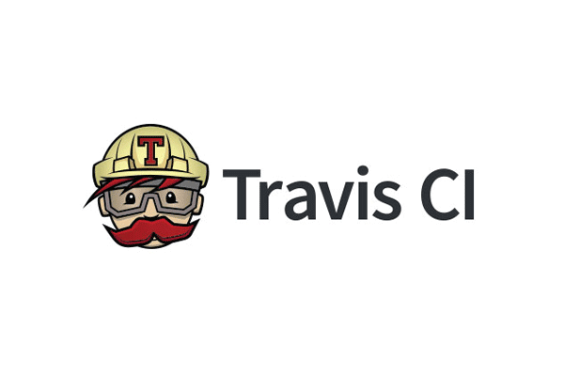
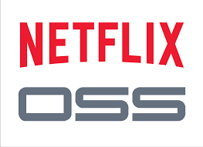
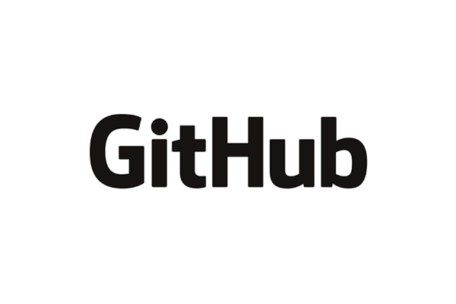


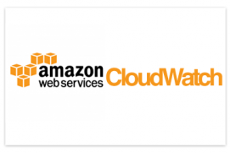
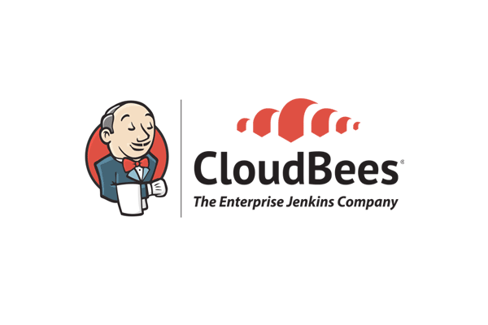
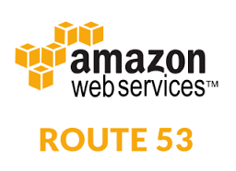

Enabling Microservice Strategy with Cloud Native Architecture (AWS)
DATABASES AND DATA MANAGEMENT
VERSION CONTROL
CI / CD
SECURITY & COMPLIANCE
OAuth
UAA
LDAP
Kerberos
SSL/TLS
PCI
HIPAA/HL7
METRICS & DASHBOARDS
AWS CloudWatch
DevOps Partners
AWS
Code
Commit
AWS
Code
Pipeline
DEV FRAMEWORKS
API MANAGEMENT
AWS
Simple
Workflow
AWS API
Management
DATA MICROSERVICES
LANGUAGES
Java
.NET
Python
DISCOVERY & REGISTRATION
Consul
Eureka
etcd
CIRCUIT BREAKERS
Hystrix
DIY
LOAD BALANCING
Ribbon
Zuul
AWS
Data Pipeline
Ruby
Go
*.JS
MONITORING & LOGGING
CONTAINERS
MESSAGING
Docker
AWS SNS
CONTAINER
ORCHESTRATION
Kubernetes Swarm Marathon ECS
NETWORKING
CLOUD ORCHESTRATION
& AUTOMATION
Chef Puppet Ansible SaltStack Mesos
PUBLIC CLOUD

Slide 15
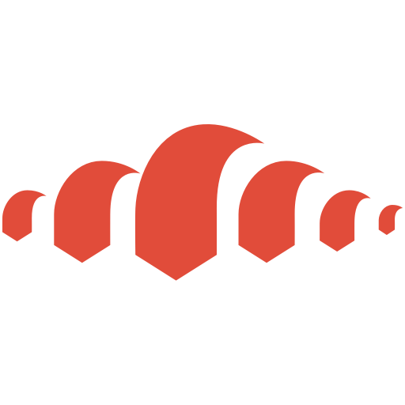
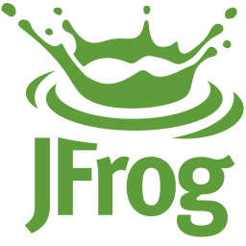
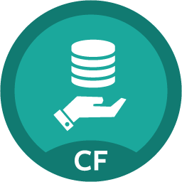
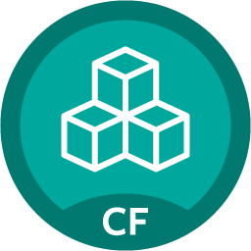
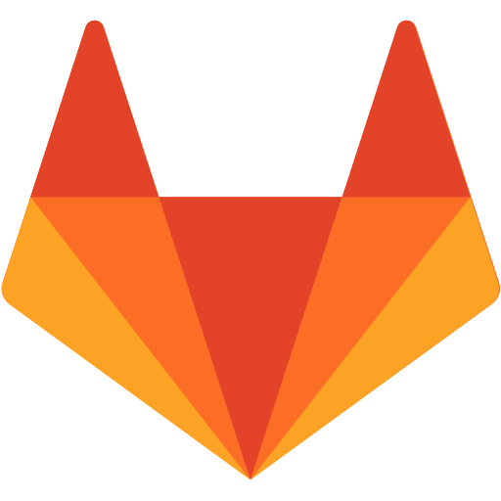
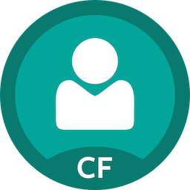
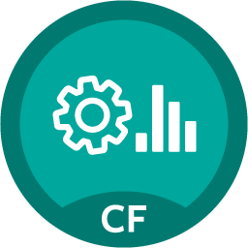
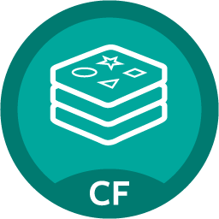
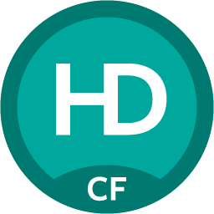
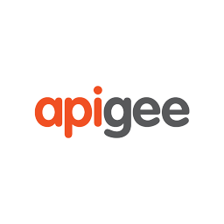

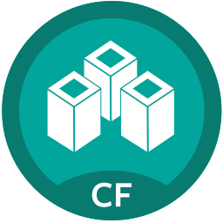
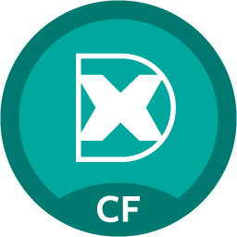
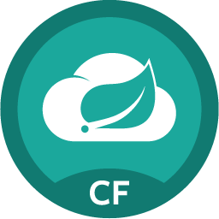













Enabling Microservice Strategy with Cloud Native Architecture (PCF)
DATABASES AND DATA MANAGEMENT
VERSION CONTROL
CI / CD
SECURITY & COMPLIANCE
SSO
IPSEC
METRICS & DASHBOARDS
PCF Metrics
PCF Logging
Gitlab
Ops Manager UI
Jenkins Artifactory
BOSH Director
CF CLI + API
MySQL Gemfire
DEV FRAMEWORKS
Buildpacks
API MANAGEMENT
Ops Manager (Admin)
Redis Pivotal HD
Apps Manager UI
Service Marketplace
CF CLI + API
DATA MICROSERVICES
LANGUAGES
Java
Python
PHP
.NET
DISCOVERY & REGISTRATION
Consul
Eureka
etcd
CIRCUIT BREAKERS
Hystrix
DIY
LOAD BALANCING
Ribbon
Zuul
Apps Manager (Dev)
Ruby
Node
Go
Spring Cloud
Dataflow
Service Broker
MONITORING / LOGGING
CONTAINERS
MESSAGING
PCF Managed
Docker RunC
RabbitMQ
PCF Provided
CONTAINER
ORCHESTRATION
PCF Elastic Runtime
Service Broker
NETWORKING
CLOUD ORCHESTRATION
& AUTOMATION
BOSH
Corp Managed
(or external)
PRIVATE CLOUD
PUBLIC CLOUD
User Provided
Azure
HA Proxy Router

Slide 16
Cloud Ready Poll
App upgrades require planned outage?
Apps are hard to scale up or scale down?
App downtime when pulling cables at random in the datacenter?
‹#›
Notes:
If you answer yes to any of these questions, you need a platform
People with Cloud Foundry on the right infrastructure say No to each question

Slide 17
It Takes a Platform
An end-to-end structured platform makes resilient distributed App
best practices, a turn-key,
first practice
‹#›
Notes:
Mention the opinionated platform.
Structured vs Unstructured.
The word platform is thrown around alot these days. You’ve probably heard the word PaaS a few times already – its become the word of the year already. However, lets make a distinction, structured platforms vs unstructured platforms.

Slide 18
Path to Full Stack Automation
Business Value, Agility & Cost Savings
Traditional IT
IaaS
Platforms
Applications
Applications
You Manage
Applications
Data
Data
Data
You Manage
Runtime
Runtime
Runtime
Middleware
Middleware
Middleware
You Manage
Pivotal CF
+
Choice of IaaS
O/S
O/S
O/S
Virtualization
Virtualization
Virtualization
Servers
Servers
IaaS
Servers
Storage
Storage
Storage
Networking
Networking
Networking
‹#›
Notes:
How you you characterize your IT stack?

Slide 19

Building a Cloud Native Platform
Choosing a
Metrics
SSO
Data
Load
Balancing
CI/CD
Java/.NET
Microservices
Spring Boot
Netflix OSS
Developer AND
Operator Agility
True Multi-cloud
Portability
Pivotal Cloud Foundry
Elastic Container Runtime
DIY Tooling:
Puppet
Chef
Ansible
Cloud formation
Terraform
Rancher
…
OS
Container Orchestration
Cloud Orchestration
CPI
Azure
‹#›
Notes:
Whata are you currently using for tooling?
Hella vs Wiked
SF vs Boston
True Multicloud portability

Slide 20







Cloud Native Platforms and Contracts
Culture
Framework
Tools
Cloud Native Ecosystem
Netflix OSS, Spring, .NET, Ruby
Python, NodeJS, and more...
App Dev
Contract: 12 Factor App
Elastic Container Runtime
Pivotal
Cloud Foundry
Platform DevOps
Contract: BOSH Release
Infrastructure Automation
bosh.io
IT Ops
Contract: Cloud Provider Interface
Azure
Notes:
And all of this is enforced through strict API contracts that allow you to go FAST and be safe.
Last time we sat down we discussed at a high level what Pivotal provides, today I want to go a bit further into the capabilities of the platform along with its integrations and points of interoperability with external systems. Its important to note that Cloud Foundry is more than a tool, rather it is a cloud native platform, whereby the architecture is purpose built for running apps in the cloud, and itself is cloud agnostic, meaning you can run the same cloud foundry PaaS across any cloud provider. To achieve this, cloud foundry is first and foremost built for running mission critical applications and microservices at scale. It empowers developers by providing the flexibility of working with Docker images, .NET applications, Spring Java, and polyglot languages all within an environment that requires nothing more than a developer to provide code. To enable this, it takes a platform that OOB provides all the logging, APM, Data, High availability, routing, DNS, through an as-a-service approach, interfacing with the underlying infrastructure. That infrastructure can be any cloud provider, and through orchestration, and automation of IaaS functions, can stand up a cloud foundry install with ease. How does a system like this work together? It requires communication, not only between Dev and Ops, but through the layers of App, Platform, and Cloud. The applications run in a platform, abiding by a contract that they be purpose built for the cloud. With frameworks like Spring Boot an app can have profiles which reduce the amount of code to change compatibility with a runtime environment in local or cloud to just a configuration file. Following the best practices set forther by 12factor.net (Heroku), a developer can construct an app to be resiliant, use polyglot persistance, implement netflix battle tested patterns, and deploy configuration changes to an app non disruptivley. On the other side, the platform and onfrastructure itself if made robust through version control of runtime configurations. BOSH our infrastructure automation agent makes versioning your infrastructure configurations a breeze, at the same time keeps the HA of the platform running reliability at all times. To ensure cross cloud compatibility, the BOSH cloud provider interface (CPI) is implemented for the cloud provider’s api. These three things together, Application Framework, Runtime Platform, and Infrasrtucture automation are the key stones fo PCF.

Slide 21









Cloud Foundry: An App-centric Platform
Roles & Policy
Centralized Log Management
Networking
& Load Balancing
Auto-Scaling
APM & Tracing
APPLICATION
Health management
Marketplace
Notes:
Tell me about your apps

Slide 22




Application Lifecycle Management: CI/CD
AUTOMATION.
Integrate tools and automate processes from testing to builds and deployment.
SPEED.
Releasing more frequently with fewer bits will reduce complexity and improve time-to-market.
QUALITY.
Shorten feedback loop using test-driven development to surface problems sooner.
AGILITY.
Push updates on regular basis with no downtime to improve customer experience and time to market.
Commit Code Change
Automate Build & Test
Manage Binaries & Build Artifacts
Pivotal Cloud Foundry (Elastic Runtime)
Build Pipeline Operations
Gitlab
Jenkins
Develop, Test, QA and Production on the same platform.
Horizontal scaling, high availability, security, logging, update management
Built-in ecosystem of services.
Deploy, operate and scale on IAAS of choice.
Simple, developer friendly commands and APIs.
Tool Chain
Build, test and deploy software projects continuously and incrementally. Thousands of compatible plugins.
Distributed revision control and source code management. Collaborative software development.
Share binaries and manage distributions. Manage artifact lifecycle.
Notes:
Highlight here that if we had a Docker step for building images, we would add ~15 minutes to the process.

Slide 23














Fast, Self-service Provisioning
Mobile
Data
CI/CD
Cloud Native
DataStax Cassandra
Config Server
App Distribution
Redis
Git Lab
Jenkins Enterprise
Service Discovery
Push Notifications
MySQL
RabbitMQ
Monitoring
Circuit Breaker
Security
Data Flow
PivotalHD
App Dynamics
Single Sign-on
Session state caching
GemFire
Powered by
New Relic

Slide 24
Four Levels of Built-In High Availability
PCF
PCF
PCF
Zone 1
Zone 2
A
B
C
A
B
C
A
B
C
A
B
C
A
B
C
A
B
C
A
B
C
VM1
VM2
VM3
B
B
B
B
Runtime VM
3. Resurrector restarts failed VMs
Process
B
A
B
C
A
B
C
A
B
C
A
B
C
OS,
Mware
OS,
Mware
OS,
Mware
B
B
B
B
If an app fails, PCF reboots app in a new container.
If a process fails, PCF restarts the process
If an OS or network failure occurs PCF kills the VM and reboots the host in a new Virtual machine.
If a datacenter rack fails, PCF ensures applications stay running in multiple availability zones
App Fail
Process Fail
VM Fail
Rack Fail
Notes:
Application performance and reliability have a direct correlation to HA capability. Pivotal provides 4 level of HA so that you don’t need to invest in people/software to handle common failure situations. If an application fails, we will reboot it in a new container. This automated remediation addresses application bugs that result in outages. If a Pivotal process fails, we will reboot it in a new virtual machine. Our PaaS essentially monitors and remediates itself. If an OS or network failure occurs, our VM monitor will detect this and kill the VM, then reboot it in a new container. This streamlines Linux sysadmin operations. Lastly, if a datacenter rack fails, we will ensure the application stays running because we load application instances in multiple availability zones. No 2 availability zones live on the same datacenter rack. This hardware failure level resilience is very difficult to design using traditional tools provided by HP/CA/IBM.
And, by using Pivotal, you reduce the number of servers that require HP/CA/IBM monitoring tools.
http://blog.pivotal.io/cloud-foundry-pivotal/products/the-four-levels-of-ha-in-pivotal-cf
Desired State of Application is maintained by Cloud Controller. DEAs communicate status of their apps to Health Manager. HM checks with CC. CC restarts app in another DEA in case of failure
PCF Processes monitored by monit and restarted in case of failure
In case of VM failure. Health Monitor is notified. HM calls BOSH Director which calls Resurrector component which starts up the VM (with processes)
Availability Zones is a logical grouping of the deployment of System Components and DEAs. (Example would be two racks in a datacenter)

Slide 25














































Pivotal Cloud Foundry: Most Trusted Platform
PLATINUM
GOLD
SILVER
Notes:
Open source software offers true community-driven outcomes. Cloud Foundry Foundation has 40+ companies that participate in the community with a vested interest in a platform that continues to grow and meet customer needs, now and in the future.

Slide 26



Cloud Foundry Open Source MOMENTUM
Commits
Submitters
53 corporations are contributing members
158 meet-ups in 49 countries
21K members with ~5K joining last month
~2200 developers, ~650 Code Submitters, ~400 of them in last year
65K commits with ~30K of those in the last year
Source: http://cloud-foundry.meetup.com/ on Jun 12 2015

Slide 27




Customer Results
“App in 10 weeks instead of 9 months”
“From 2 months for provisioning servers to deliver product in less than 5 weeks”
“The lean, agile product development practice we’ve stood up in partnership with Pivotal labs is a vehicle for cultural transformation.”
“18 lines of code to get a database, messaging middleware and an app server - kind of amazing!”
“Experience really been positive. Helped us become more “T” shaped engineers”
Notes:
Pivotal is the fastest growing open source company in history.
We are getting some good results for our customers. We would love to work with you further.

Slide 28


D E M O
Notes:
Scale Demo – its the fastest to stage
Do not go too deep into all the features if PCF.
This is an application status overview, we can scale and show high availability
Then do Spring Music via Jenkins
Show Metrics
If time, show Splunk

Slide 29
Pivotal Cloud Foundry at a Glance
Platform Runtime
Services
Routing
Container Scheduling
Service Discovery
Configuration
Database
Application Framework
Big Data
12 Factor Apps
Microservices
RESTful Services
Circuit Breakers
Object Storage
Mobile
Spring Boot
Ruby on Rails
Node.js
.NET
Build CI
User Provided
Logging & Metrics
Messaging
Operations
Zero Downtime Deployments
Failover & Recovery
Scaling
Security Patching
Platform
Upgrades
Azure

Slide 30
EXTRA
‹#›
Notes:
I wanted to go over some of these emerging development models and
how tech companies have been successful in moving to these highly composable, resilient application architectures that we’re referring to as cloud native applications.
I want to show you what kind of platform tools the leading tech companies had to build.
And how these new designs are really hitting a lot of enterprises, companies that don’t depend on software directly.
We also want to showcase how these projects work together with a demo of a microservice-based Java app, built with Spring Boot and Netflix OSS projects
Before we turn it over to discussion

Slide 31

Pivotal Cloud Foundry Business Model
Open source software provides the core platform runtime
Commercial distribution provides enterprise & production ready services, support, docs, certifications, and more…
Notes:
Our company may be young, but the codebase has developed over many years. Many of the original developers are still at Pivotal.
Cloud Foundry Open source software provides the foundation for the Pivotal Cloud Foundry platform. Commercial distribution provides enterprise services, support, docs, certs etc.
For more differences between Opensource and PCF: https://sites.google.com/a/pivotal.io/inside-pivotal-competitive-intelligence-page/oss

